Slide 1
GTU - COMPUTER ENGINEERING STUDENT CLUBS MANAGEMENT SOFTWARE
CSE 496 PRELIMINARY PRESENTATION
Muhammed OĞUZ
Süleyman GÖLBOL
Project Supervisors:
Research Assoc. Evren Çifci
Assoc. Prof. Mehmet Göktürk
April 2023

Slide 2
Contents
Project Schema and Description
Project Design Plan
Project Requirements
Success Criteria
References

Slide 3

Project Schema and Description
https://ogrenciprojeleri.gtu.edu.tr/KulupYonetim
The student clubs management system app offers three login options: member, club admin, and SKS (full admin). Members can join clubs and communicate with others, while club admins have additional privileges, such as managing events and approving new members. SKS users have full control over the app. Overall, the app provides a streamlined solution for student organizations to manage their operations and engage with members effectively.

Slide 4
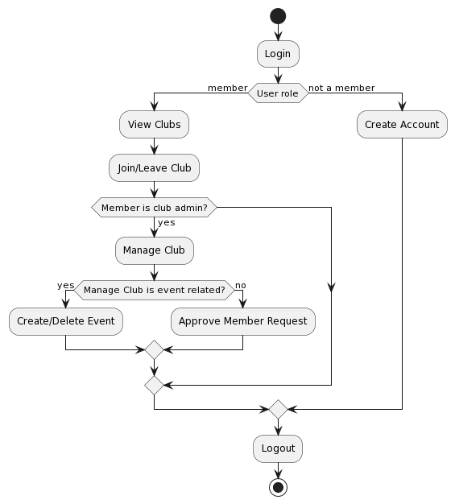
Project Design Plan

Slide 5
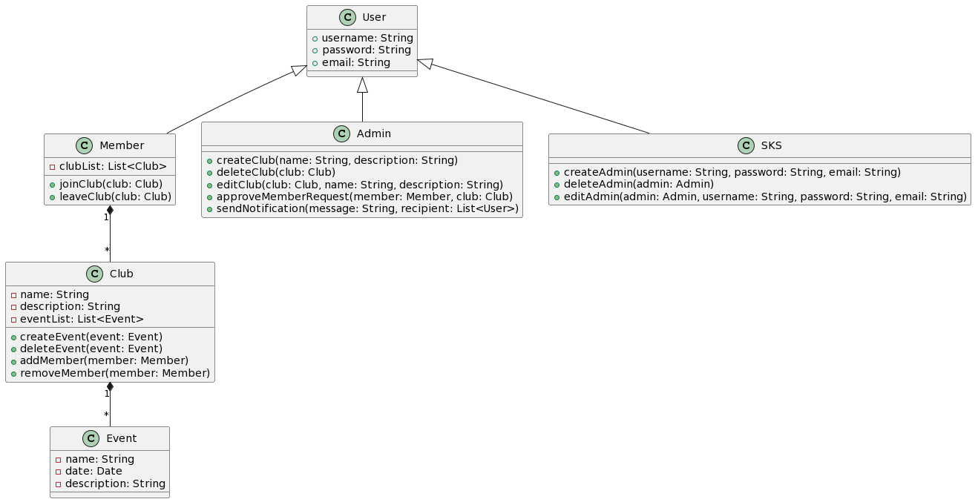
UML Diagram

Slide 6
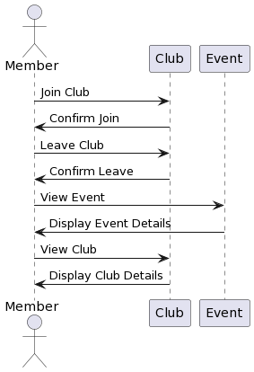
Use Case Diagram

Slide 7
Project Requirements - 1
Functional Requirements
User Management: The system should allow users to create accounts, login, and logout securely.
Club Management: The system should allow club admins to create, delete, and edit clubs. Club members should be able to join and leave clubs.
Event Management: The system should allow club admins to create and delete events for their respective clubs.
Communication: The system should allow club admins to send notifications to club members.
Membership Approval: The system should allow an SKS admin to approve or reject new member requests.
Administration: The system should allow an SKS admin to create, edit, and delete club admins and SKS admins.

Slide 8
Project Requirements - 2
Non-functional Requirements
Security: The system should provide secure access control to ensure that only authorized users can access the system.
Scalability: The system should be able to handle a large number of users, clubs, and events.
Reliability: The system should be reliable and available at all times.
Usability: The system should be easy to use and navigate, with a user-friendly interface.
Performance: The system should be fast and responsive, with minimal delays when accessing data or performing actions.
These requirements are just a starting point and may need to be customized based on the specific needs and constraints of your project.

Slide 9
.NET / React
• Frontend
– Reactjs will be used for client side.
– MUI style library could be implemented for beautiful user
design.
• Backend
– Backend language is C# and .Net framework.
– MVC architecture will be used.
– Visual Studio Code will be the main code editor

Slide 10
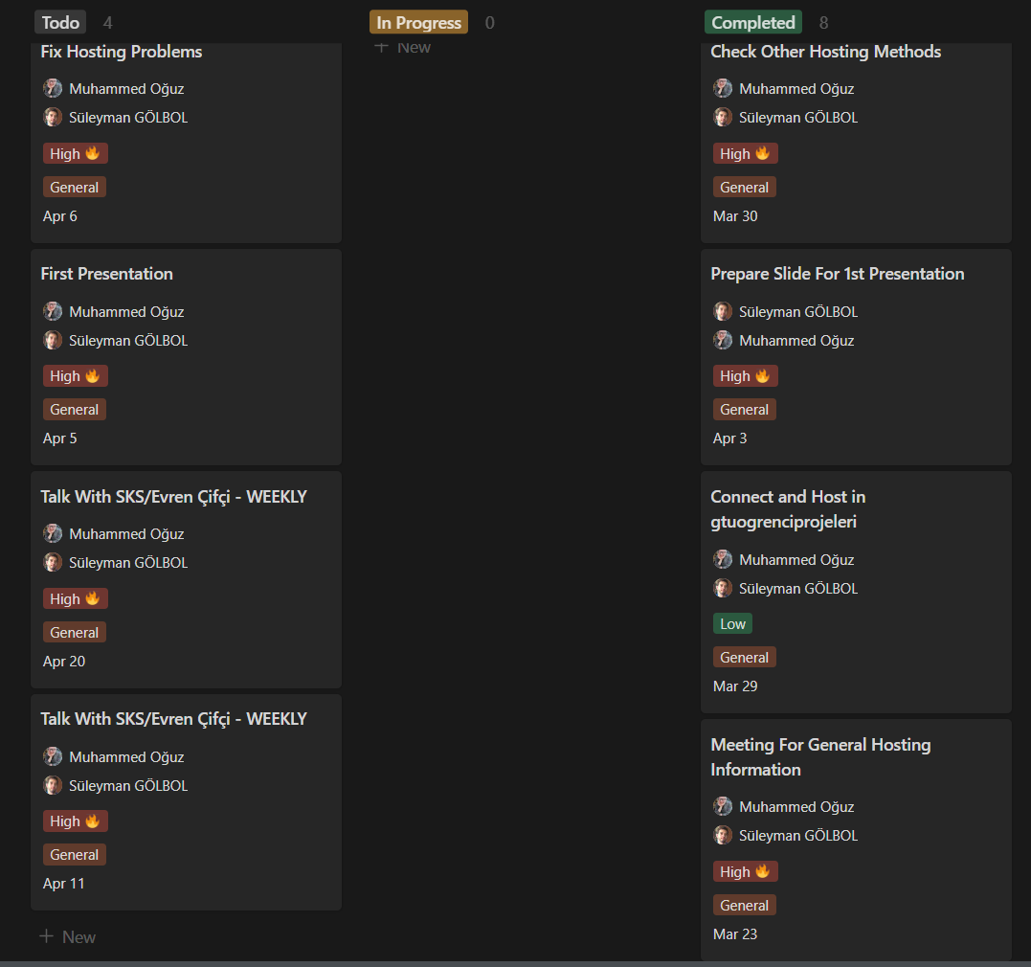
Planning

Slide 11
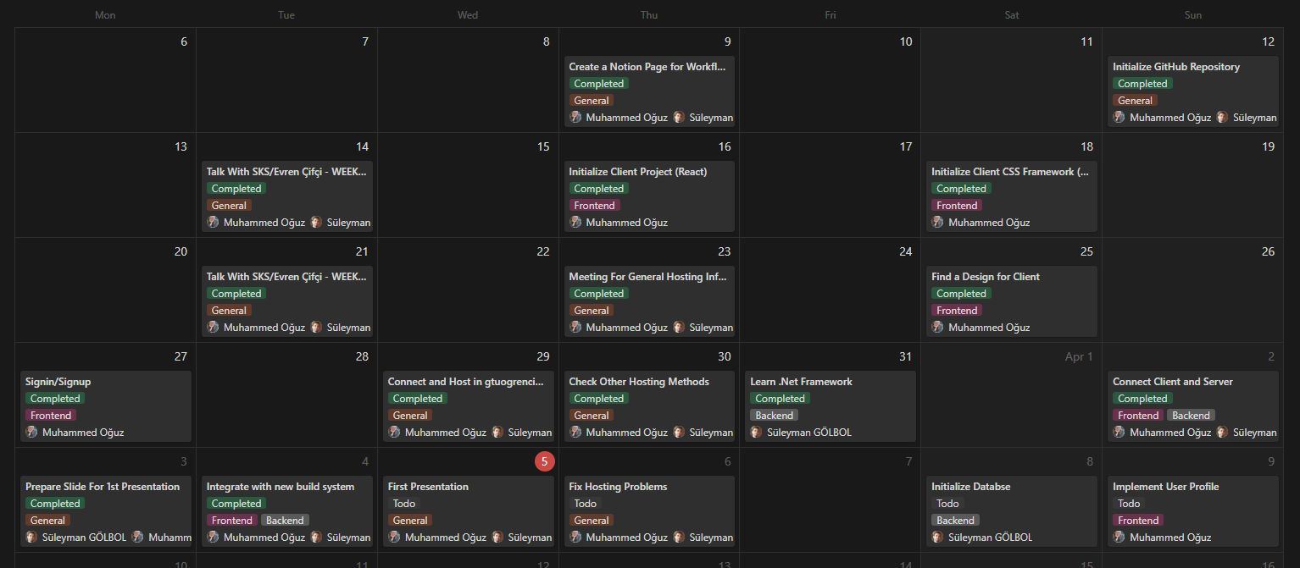
Timeline (Completed)

Slide 12
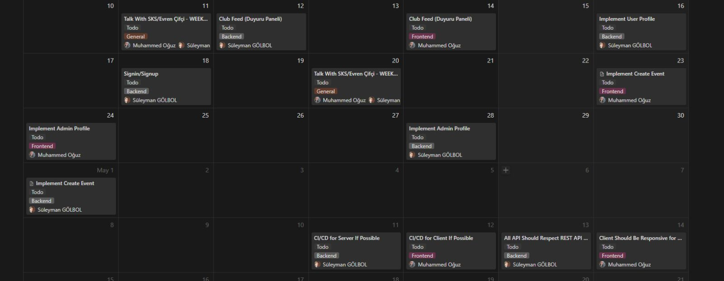
Timeline (Next Steps)

Slide 13
Timeline
1st Meeting (Preliminary Presentation) | April 05, 2023, Wednesday
2nd Meeting | May 17, 2023, Wednesday
Report Submission | June 18, 2023, Sunday
Trailer Submission | June 18, 2023, Sunday
3rd Meeting (Final Presentation) | June 21, 2023, Wednesday
Demo | June 22, 2023, Thursday
Gathering datasets, creating model.
Training, model fixes on project.
Creating application for testing.

Slide 14
Success Criteria
1. The system should integrate with other systems or services as needed, such as Outh3 portal for login authentication.
2. Response should be made at most 30 milliseconds.
3. The system should be responsive for mobile and desktop devices.
4. APIs should be proper for REST.

Slide 15
References
https://dotnet.microsoft.com/en-us/
https://react.dev/
https://nodejs.org/en
GTU BIM / SKS (Evren Çifci)

